Slide 1

The ‘1’ is the ‘0s’-
Data Meets Discrimination

Slide 2



The ‘1’ in the ‘0s’
Data Meets Discrimination
Submitted in partial fulfilment of the requirements for the award of the degree of
Bachelors of Computer Application
TO
Guru Gobind Singh Indraprastha University, Delhi
Institute of Innovation in Technology & Management
New Delhi- 110058

Slide 3
Trainer:
Submitted by:
Mr. Prateek Gupta
Data Scientist
Hritvi 03824402024
Arshleen Kaur 09024402024
Pranjal Tiwari 03224402024
Vansh Chandna 50119202024
Faculty:
Ms. Sushma Sethi
Assitant Professor

Slide 4
Agenda
1
2
3
4
5
6
7
8
Introduction to python
Python and Its Libraries
Power Bi Dashboard
SQL(Structured Query Language)
Advance Excel
Linkedin Post
Conclusion
Thank You

Slide 5





Why Python?
Syntax
Low-level, verbose, manual memory management
Verbose, object-oriented
Very simple and readable
Multi-paradigm
(OO, procedural)
Paradigm
Procedural
Object-Oriented

Slide 6
Introduction to Python
Python is a high-level, interpreted programming language known for its simplicity, readability, and versatility.
It’s one of the most popular languages in the world used in everything from web development and data analysis to AI, automation, and cybersecurity.
First released in 1991.

Slide 7

Pros of Python
01
Easy to Learn and Use Python’s syntax is simple and readable. Great for beginners and widely used in schools and universities.
03
Cross-PlatformPython runs on Windows, macOS, Linux, and more.
Versatile
Used in web development, data science, AI/ML, automation, game development, etc.
04
Open SourceFree to use and distribute—even for commercial use. .
02

Slide 8

Cons of Python
01
Slower Speed Python is interpreted, not compiled, so it runs slower than languages like C++ or Java. Not ideal for performance-critical tasks like real-time systems or games.
03
Memory Consumption -High memory usage, which may be inefficient for applications where system resources are limited.
02
Mobile Development Limitations Not commonly used for mobile app development (though tools like Kivy exist).
04
Limited in Browsers Python can't run in a web browser like JavaScript can.

Slide 9



Applications
Python is used in many real-world applications across industries due to its simplicity and power.
Here's a list of the top applications of Python:
Data Science
& Data Analysis
Machine Learning & Artificial Intelligence
Game & Web
Development

Slide 10
Python and Its Libraries
A set of modules or functions that provide specific functionality, such as math operations, file handling, web requests, machine learning, or data visualization.
This project utilizes four essential Python libraries — NumPy for numerical operations, Pandas for data manipulation, Matplotlib for basic visualizations, and Seaborn for advanced, aesthetically pleasing charts — together forming a complete pipeline from raw data to compelling insights.

Slide 11

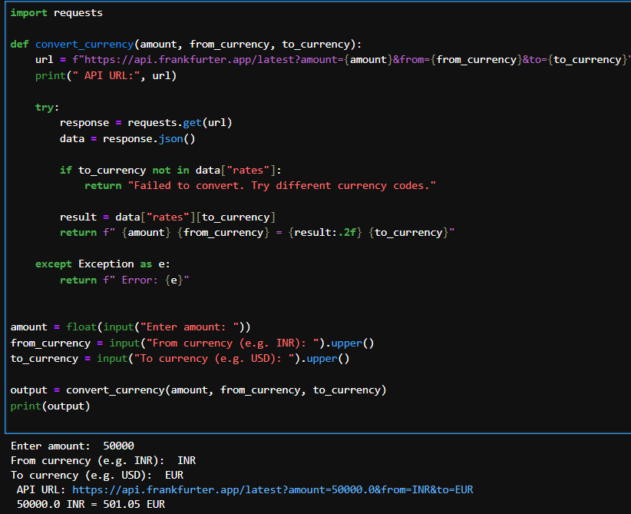
Currency Converter
Pranjal Tiwari

Slide 12
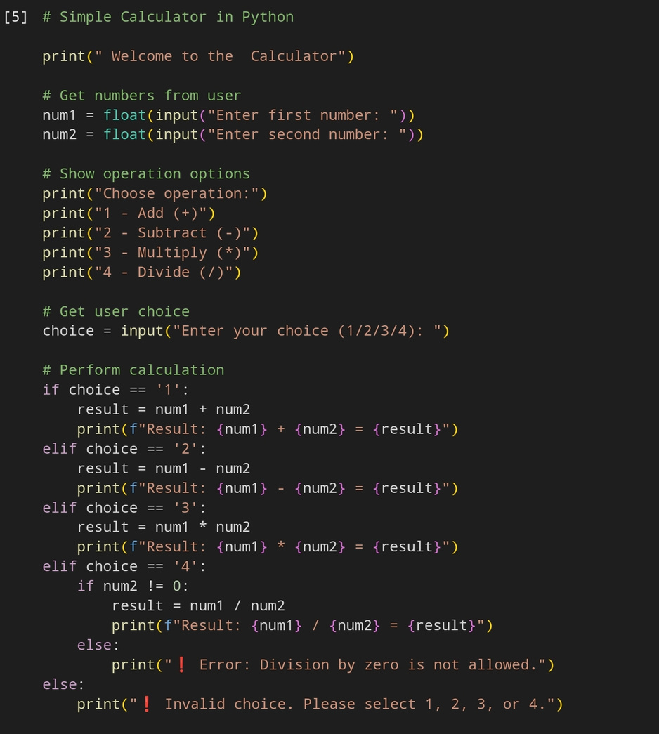
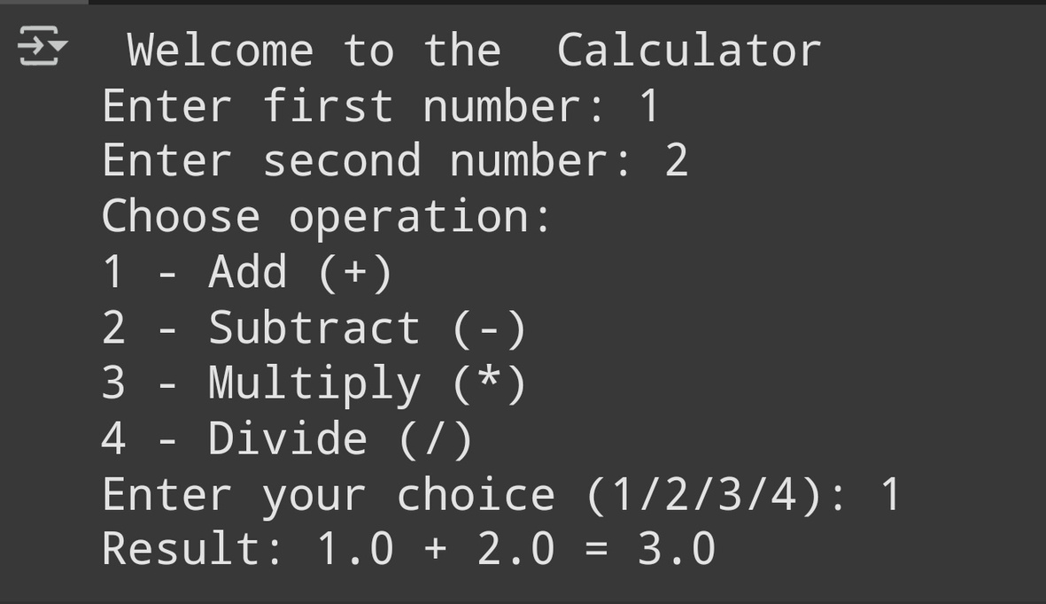
Calculator
Hrtivi Maheshwari

Slide 13
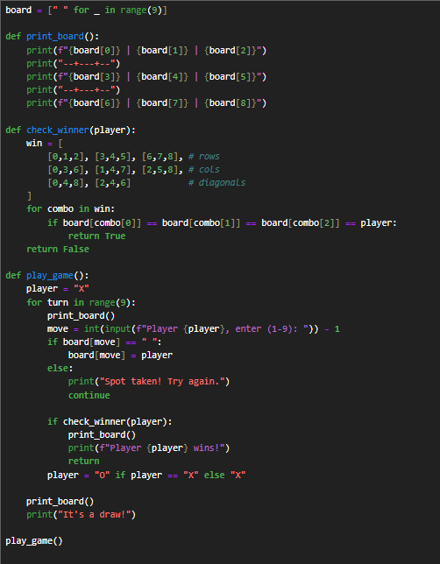
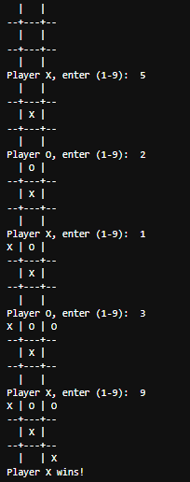
Tic Tac Toe Game
Arshleen Kaur

Slide 14
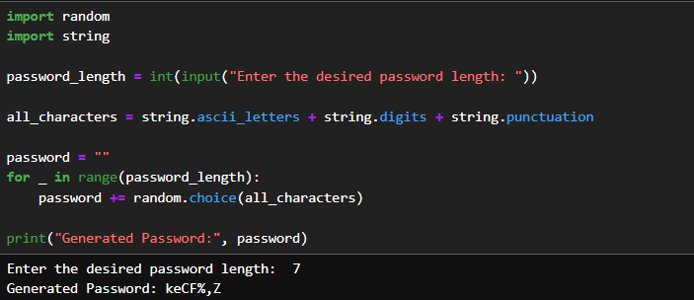
Password Generator
Vansh Chandna

Slide 15

NUMPY
It stands for Numerical Python
It deals with Array
Array is a rectangular matrix which is made of rows and columns
We can do Slicing and indexing in array.
It has various powerfull functions Various methods are available
It is better than list.
It consist of same data typedata Manipulation and data generation.

Slide 16
NumPy
Pros
Cons
Not Flexible
Debugging
Requires External Installation
Less Useful for Small Tasks
Cannot Handle Complex Data Structures
Fast Performance
Memory Efficient
Powerful N-D
Interoperable
Open Source

Slide 17
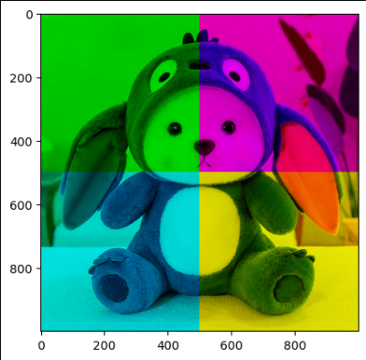
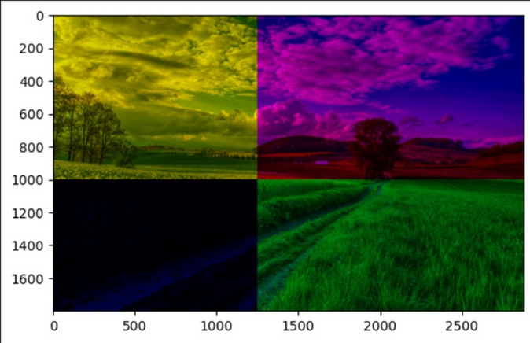
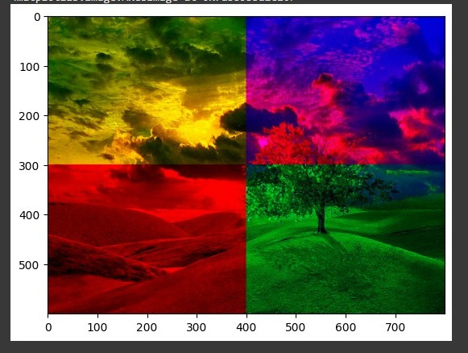
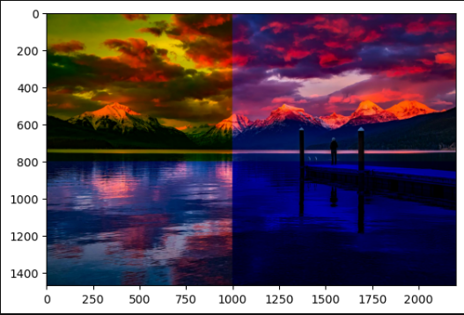
Numpy Mini Projects
Pranjal Tiwari
Arshleen Kaur
Hrtivi Maheshwari
Vansh Chandna

Slide 18
Aim
*The aim of this data analytics project is to analyze responses collected through a self-designed Google Form survey focused on caste, gender, and reservation-based experiences in India.
*The project involves cleaning and preprocessing the raw survey data to ensure accuracy and consistency.
*Using visualization techniques and an interactive dashboard, the goal is to uncover meaningful patterns and correlations related to social identity, discrimination, and access to opportunities in education and employment.
*The final output is intended to present insights in an accessible and impactful way for informed discussion and decision-making.

Slide 19

Pandas
Power of Pandas: Mastering Data with Python
The essential data analysis tool every data scientist should know

Slide 20
What is Pandas?
Pandas is an open-source data manipulation and analysis library for Python.
It is widely used in data science, machine learning, and data analysis tasks due to its powerful, flexible, and easy-to-use data structures.
Pandas provides two main data structures:
Series – 1-dimensional labeled array (like a column in Excel).
DataFrame – 2-dimensional labeled data structure (like a table or Excel sheet).

Slide 21
Why is pandas Important in
Data Analysis & Data Science?
Efficient Data Handling
Can load, view, clean, and transform large datasets with just a few lines of code.
Tabular Data Made Easy
Works like a supercharged Excel spreadsheet but with Python power.
3. Powerful Data Manipulation
Supports filtering, sorting, merging, pivoting, grouping, and reshaping data.
4. Saves Time & Reduces Code
Replaces long loops and complex logic with clean, readable one-liners.

Slide 22
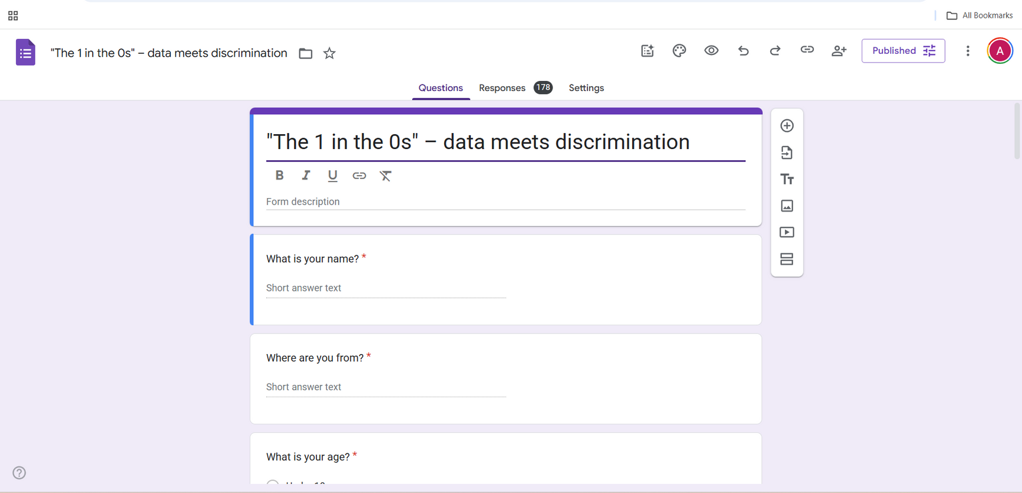

Information Gathering
The data used in this project was collected through a Google Form survey designed and distributed by our team. The survey aimed to capture the lived experiences and perspectives of individuals from diverse social backgrounds across India, focusing on caste category, gender identity, age group, geographic location, and professional or academic position. Respondents were also asked about their experiences with reservation benefits, perceptions of discrimination, and the nature of selection and promotion in their respective fields.
The form included both objective and subjective questions, and participation was voluntary. The collected data serves as the foundation for further analysis, visualization, and dashboard development.

Slide 23
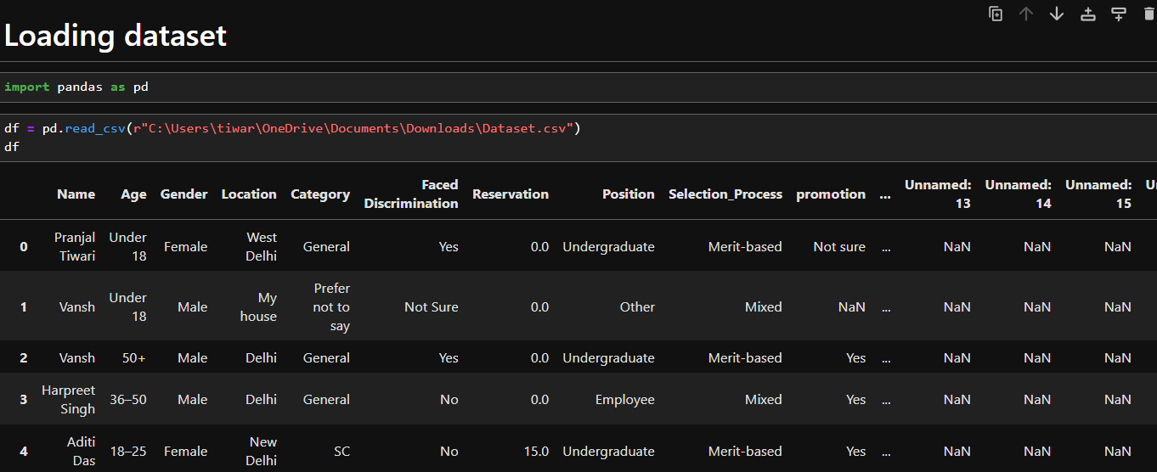
Data Loading
What is Data Loading?
Data loading is the process of importing data from a source (like a file, database, or web service) into your program or analysis environment so you can work with it.
Why Is Data Loading Important?
Almost every data-related task—like analysis, visualization, or machine learning—starts with getting the data into memory.

Slide 24
Data Exploring
What is Exploring of Data ?
Information gathering is the process of collecting relevant data or knowledge to solve a problem, make decisions, or build something—like a report, software, or analysis.
In General Terms:
It answers “What do I need to know?” and “Where can I find it?”
#shape
#info
#mean
#median
#std((name.column_name.std()))
#head
#tail
#count
#describe
#min
#max

Slide 25
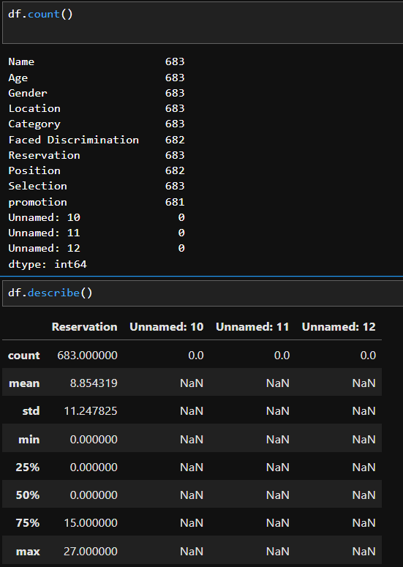
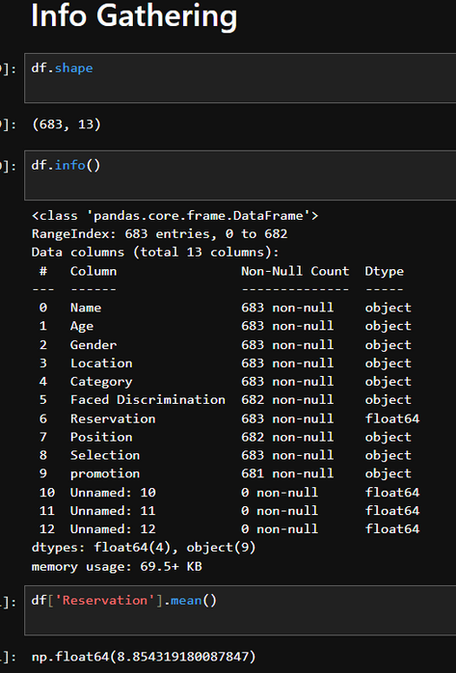
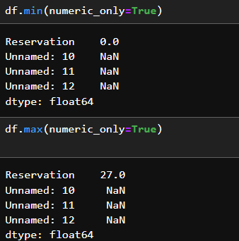
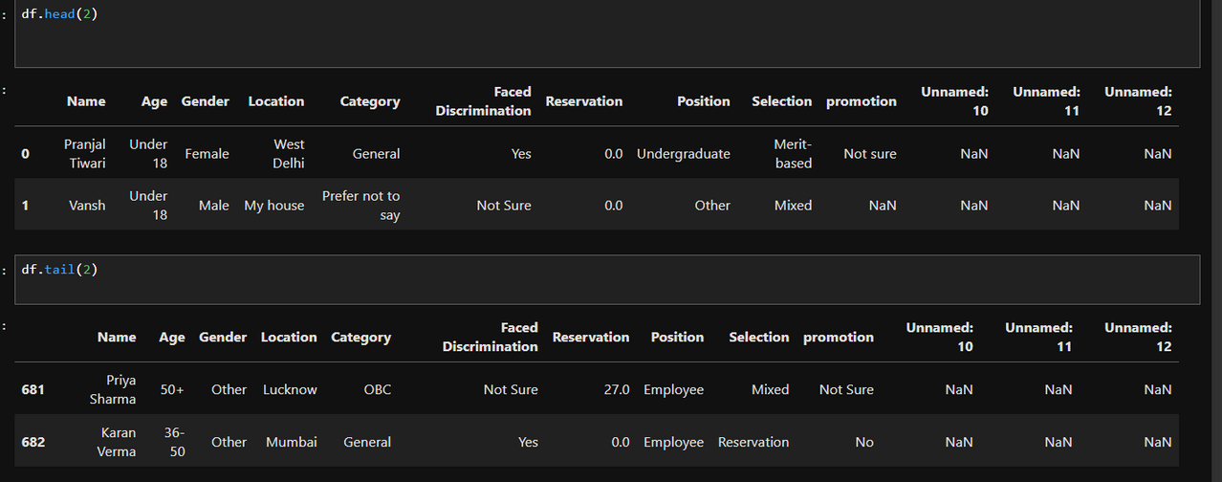
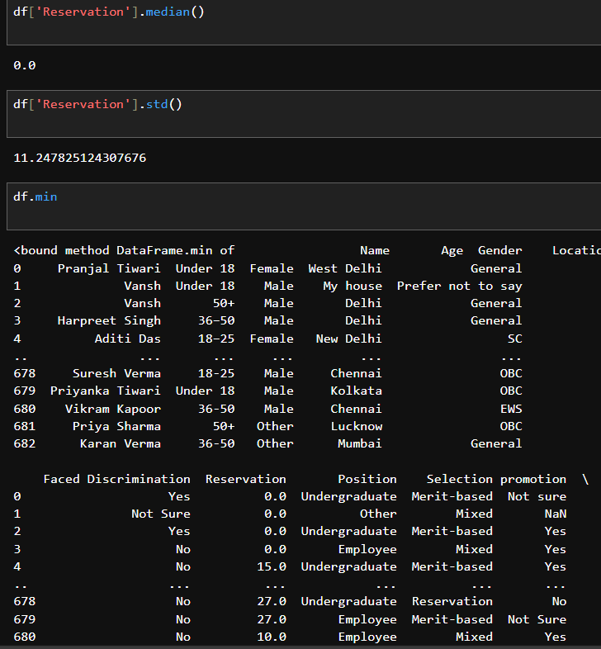

Slide 26
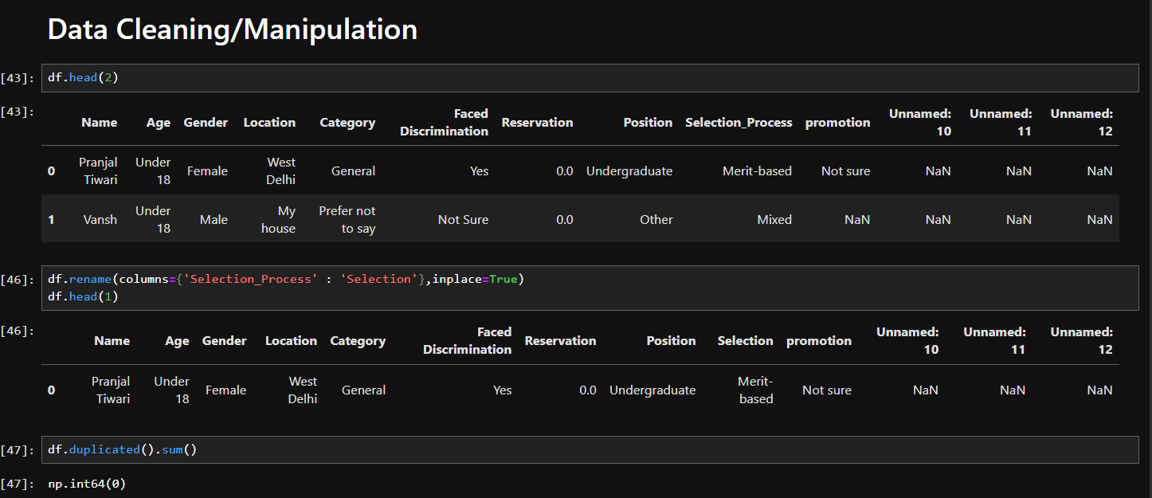
Data Cleaning/Manipulating
What is Data Cleaning?
Data cleaning (or data cleansing) is the process of fixing or removing incorrect, corrupted, or incomplete data from a dataset to improve its quality and reliability.
Why Is Data Cleaning Important?
Raw data is often messy:
Missing values
Duplicate records
Inconsistent formats
(e.g., "Male", "male", "M")

Slide 27
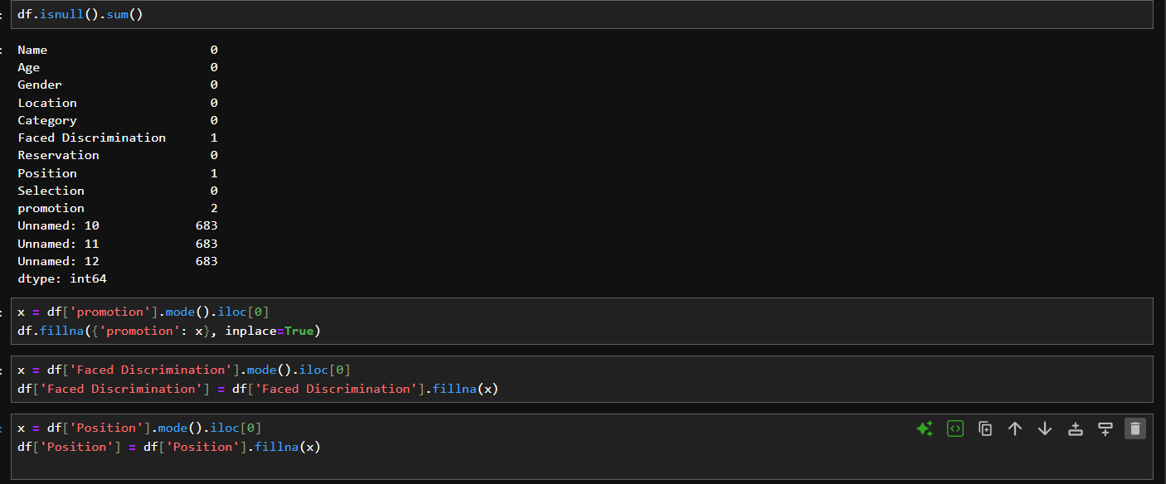
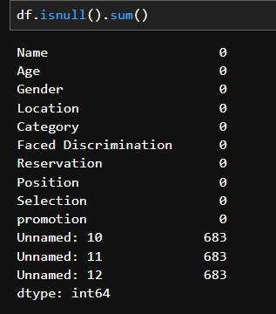
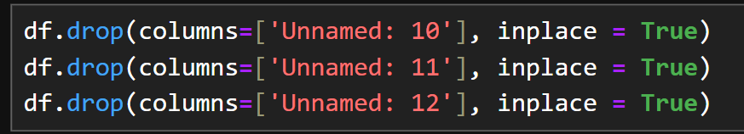
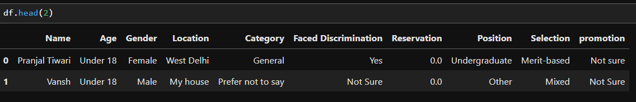

Slide 28
Sorting & Filtering
These two operations are essential for narrowing down insights
and organizing your dataset during analysis.
Sorting Data
Sorting helps organize your DataFrame based on column values (alphabetically or numerically).
Filtering Data
Filtering means selecting rows based on specific conditions.

Slide 29
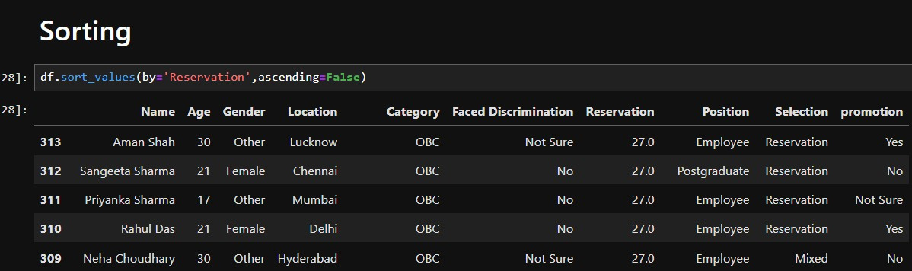
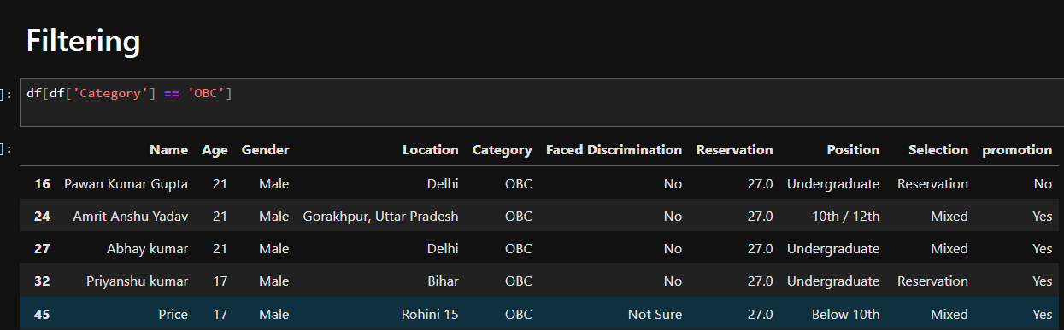
Sorting & Filtering

Slide 30
Summary
Without pandas, data scientists would spend more time cleaning and reshaping data than actually analyzing it or building models.

Slide 31
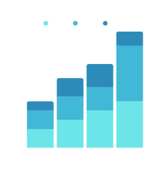
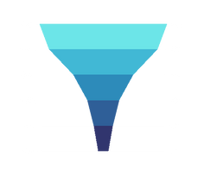

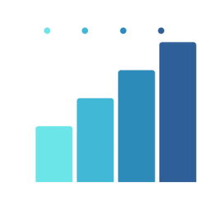
Matplotlib
Visualize Like a Pro with Matplotlib
Transform Data into Insightful Plots

Slide 32
Matplotlib
Matplotlib is a popular Python library for creating static, animated, and interactive visualizations.
It is especially well-suited for plotting 2D charts and is widely used in data science, engineering, and scientific computing.
The core module is matplotlib.pyplot, often imported as:
python
Copy
Edit
import matplotlib.pyplot as plt

Slide 33
Why Data Visualization Matters in
Data Analysis & Storytelling
1.Our Brain Understands Visuals Faster
We process images 60,000x faster than text
A chart can show patterns or outliers instantly — something raw tables can’t do
2.Turns Data Into Insight
Helps you spot trends, compare categories, and track changes over time
Enables decision-makers to understand key findings without reading code
3.Tells a Compelling Story
Good plots communicate a message, not just show numbers
Visualization adds emotion, clarity, and focus to your analysis
4.Makes Data Accessible to Everyone
Not everyone can read Python or SQL
But everyone can understand a bar chart or pie chart

Slide 34

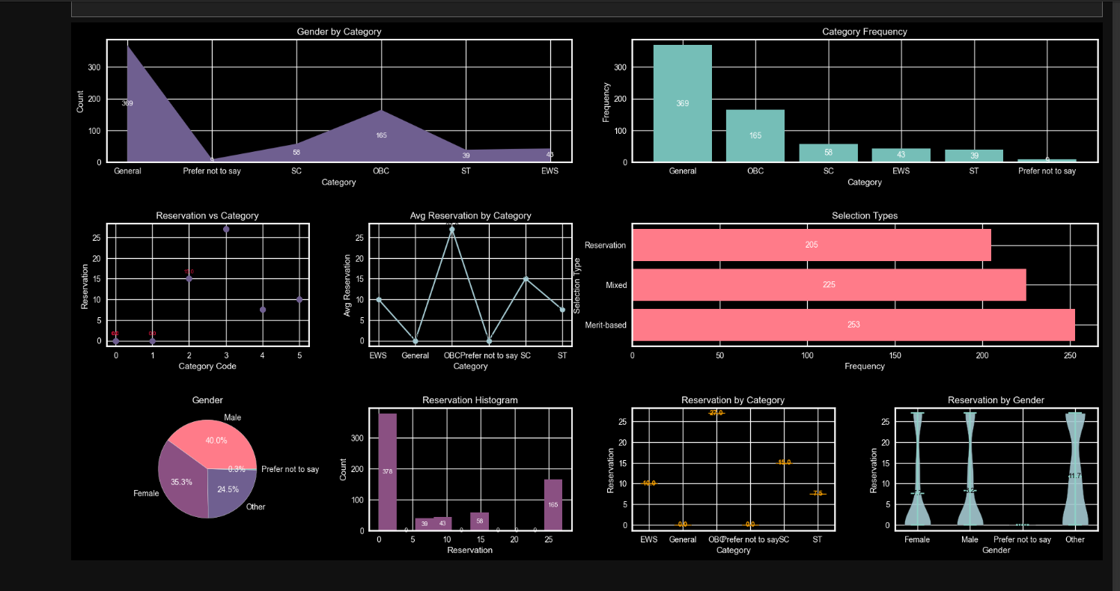
Matplotlib Mini Project

Slide 35
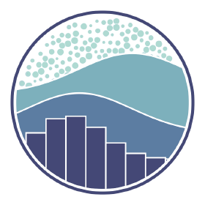
Seaborn
Seaborn Unleashed: Beautiful Data Visualizations Made Simple
Discover the power of statistical plotting in Python

Slide 36
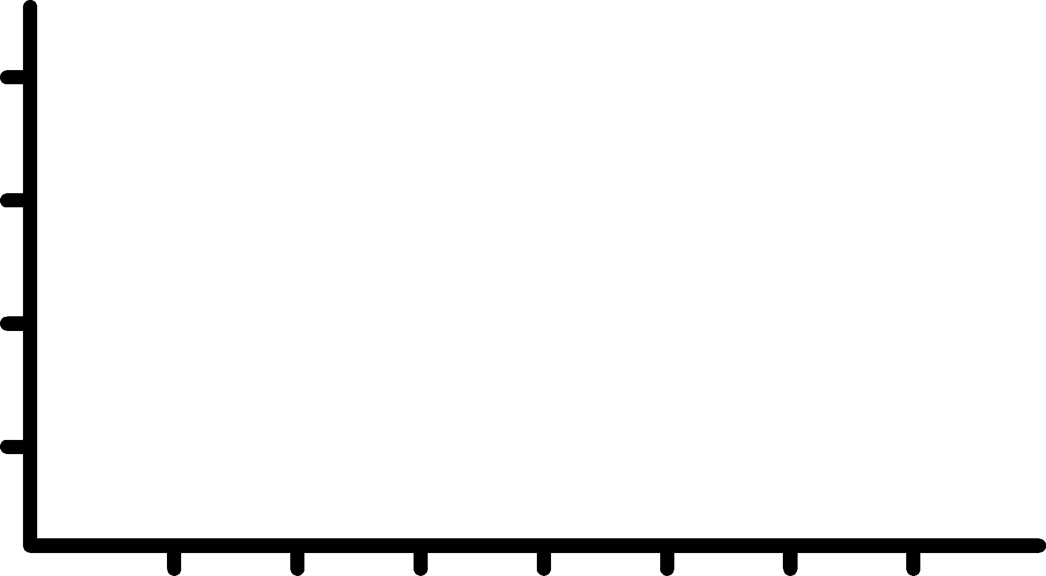
Seaborn
Seaborn is a high-level Python data visualization library built on top of Matplotlib.
It provides a simpler, more intuitive interface for creating statistical graphics, especially when working with pandas DataFrames.
To use it, you typically import it as:
import seaborn as sns
import matplotlib.pyplot as plt # Still needed for fine-tuning

Slide 37
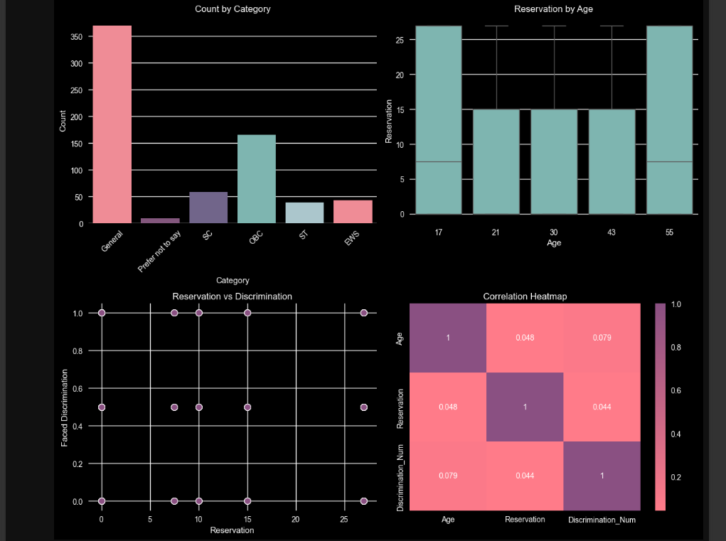

S
E
A
B
O
R
N
M
I
N
I
P
R
O
J
E
C
T

Slide 38
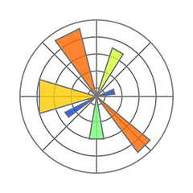
Matplotlib
Seaborn
Purpose
General-purpose
plotting library
Statistical data visualization
Integration
Works with NumPy, pandas, etc.
Built on Matplotlib, integrates smoothly
Limited without extensions
Limited, mainly static plots
Interactivity

Slide 39

Summary
Use Matplotlib when you need full control and customization over your plots.
Use Seaborn when you want quick, beautiful statistical graphics with minimal effort.
Often used together: Seaborn handles the style and statistics, Matplotlib fine-tunes the details.

Slide 40


Power BI
Power BI: Unlock the Power of Your Data
Visualize, Analyze, and Collaborate

Slide 41

Power BI Dashboard
What is Power BI?
Power BI is a business analytics tool developed by Microsoft that helps users visualize data, create interactive dashboards, and share insights across their organization.
It enables non-technical users to pull data from various sources, analyze it, and make data-driven decisions through rich visual reports.

Slide 42
What Can You Do with Power BI?
Import and clean data from multiple sources (Excel, SQL, web, APIs, etc.)
Transform and shape data using Power Query
Create interactive visualizations like:
Bar/line charts
Maps
Gauges
KPI indicators
Use DAX (Data Analysis Expressions) for advanced calculations
Build dashboards and automated reports
Share reports securely with others in your organization

Slide 43
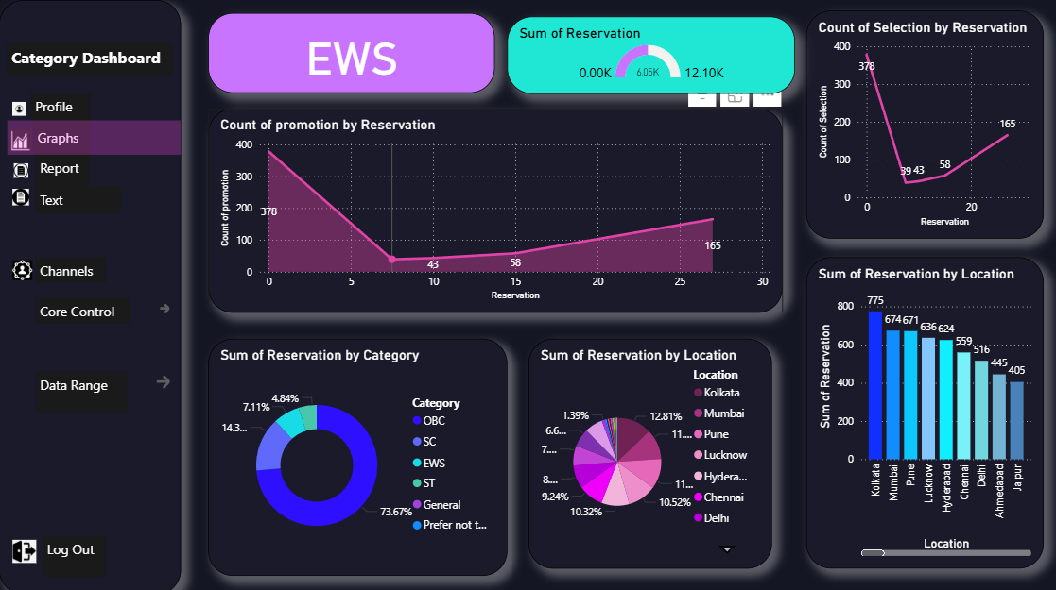
Arshleen Kaur

Slide 44
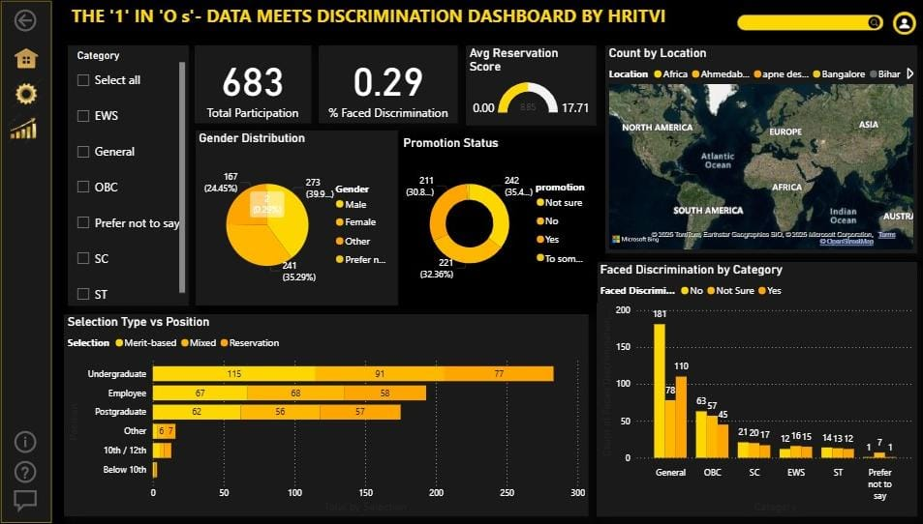

Slide 45
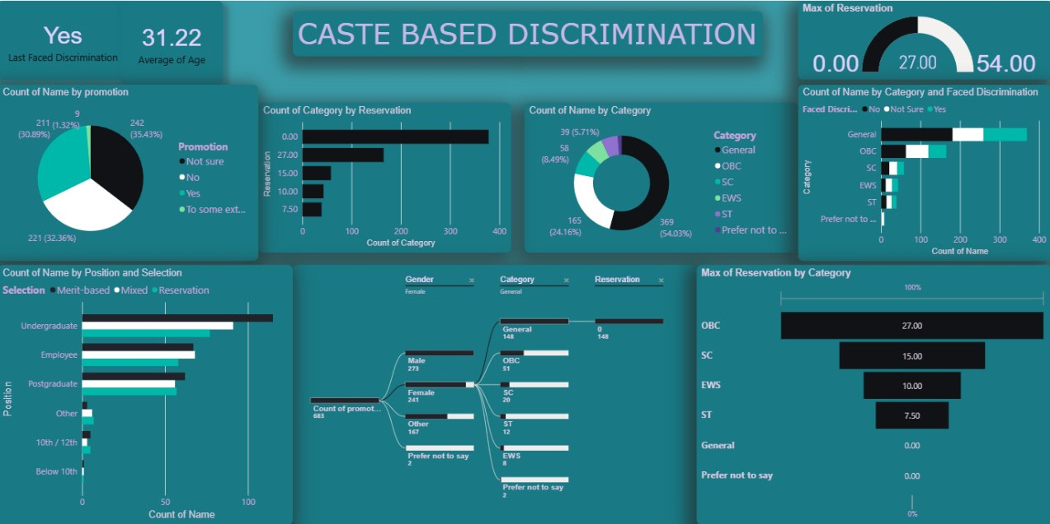
Pranjal Tiwari

Slide 46
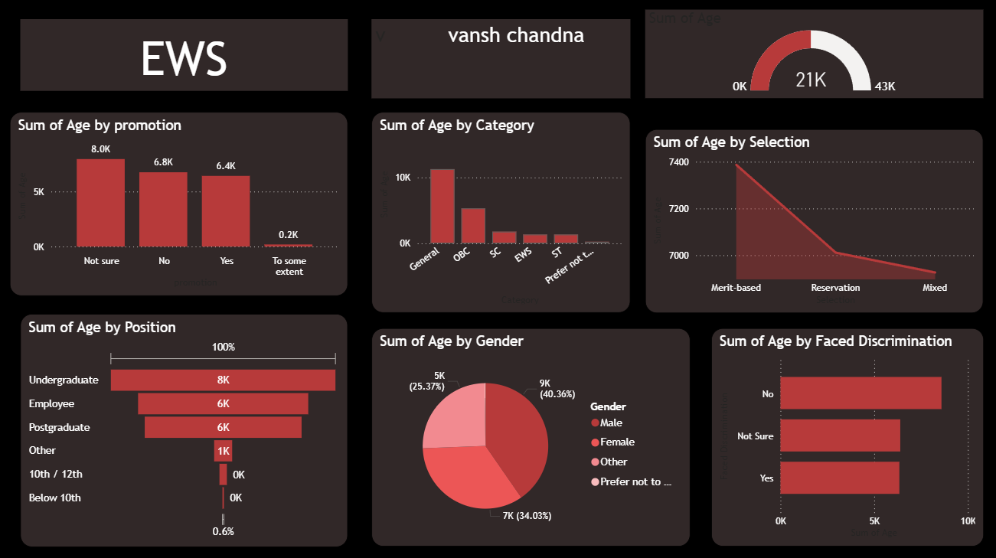
Vansh Chandna

Slide 47

Excel
Excel Power: Unlocking Your Data’s Potential
From Basics to Business Intelligence

Slide 48

What is Excel?
Microsoft Excel is a spreadsheet application used for data entry, calculation, analysis, and visualization.
It’s one of the most widely used tools in business, education, and research.
Excel organizes data into rows and columns, forming cells, which can contain text, numbers, formulas, or functions.

Slide 49
What Can You Do with Excel?
Enter and store data
Perform calculations using formulas and functions
Create charts and graphs (bar, line, pie, etc.)
Sort and filter data easily
Work with what-if analysis, goal seek, and scenario manager

Slide 50
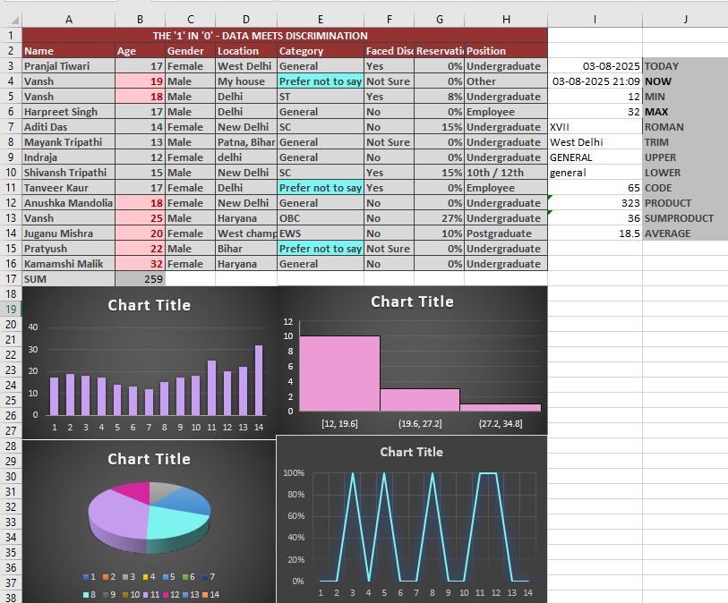

Excel
Column chart
histogram
pie chart
line chart

Slide 51

SQL
From Tables to Trends: An SQL Exploration
The Key to Managing and Analyzing Databases

Slide 52
SQL
(Structured Query Language)
SQL (Structured Query Language) is a programming language used to manage and manipulate relational databases. It is the standard language for interacting with RDBMS (Relational Database Management Systems) like MySQL, PostgreSQL, SQL Server, Oracle, and SQLite.

Slide 53
What Can You Do with SQL?
Create and modify database structures (tables, indexes, etc.)
Insert, update, delete, and retrieve data
Filter, sort, and group data
Use joins to combine data from multiple tables
Perform calculations and aggregations (sum, count, avg, etc.)

Slide 54
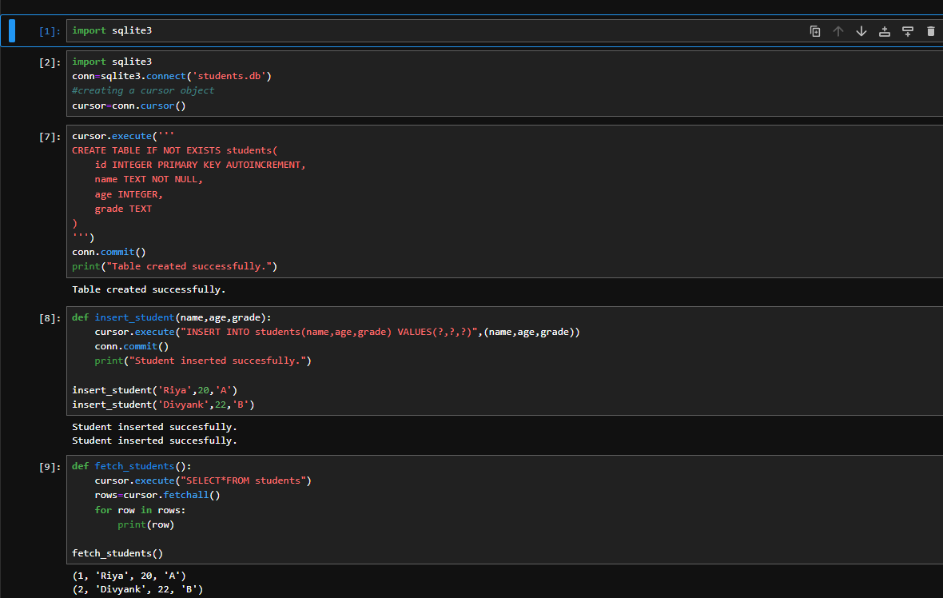

Slide 55

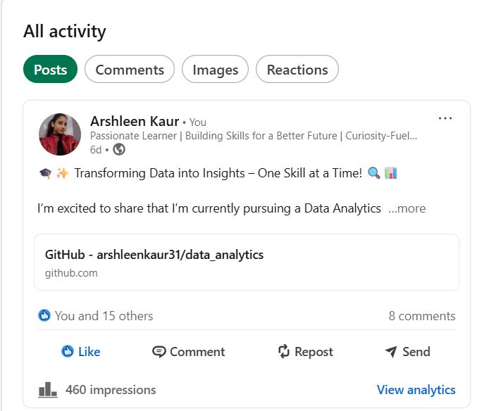
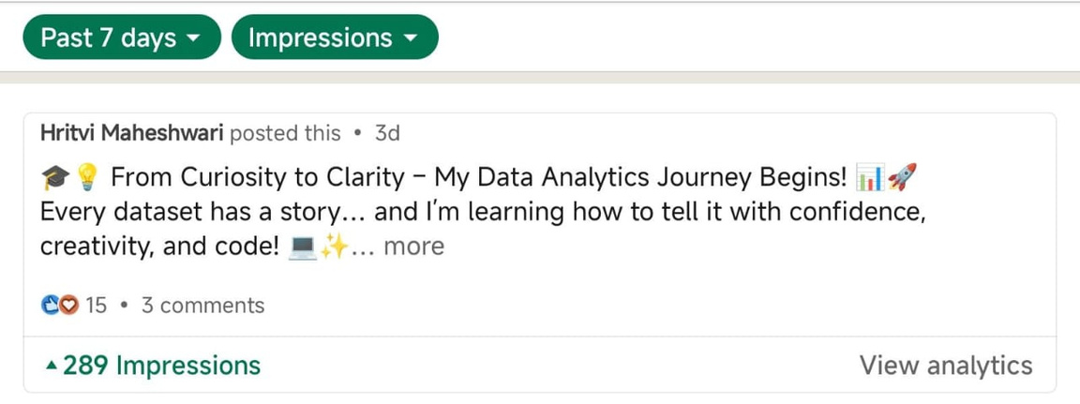
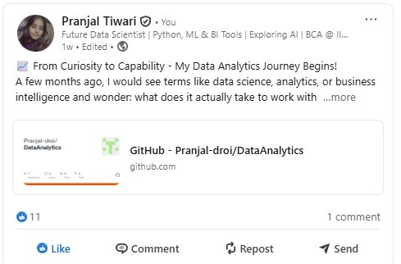
Linked
Posts

Slide 56
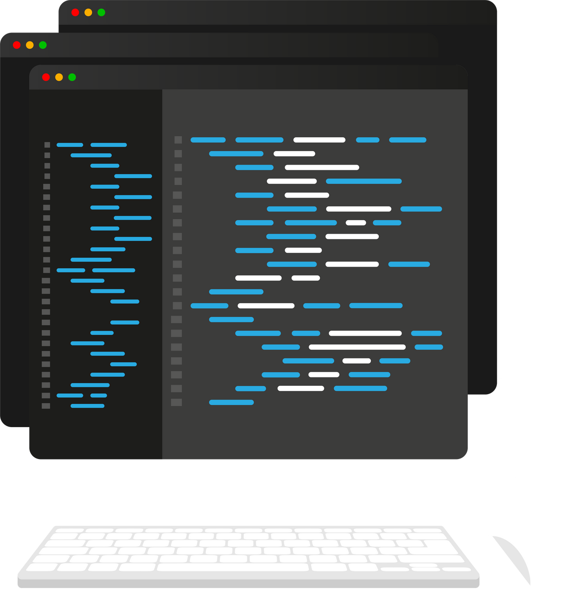
Conclusion
Clean messy data with Python (Pandas & NumPy)
Detect and fix errors, handle missing values, reshape datasets, and organize chaos into structured, analysis-ready formats using intuitive Python code.
Analyze & compute with NumPy
Perform fast mathematical calculations, work with large datasets in arrays, and gain deep statistical insights that Excel can’t handle efficiently.
Visualize insights using Matplotlib & Seaborn
Create clear, professional charts (bar graphs, line plots, pie charts) with Matplotlib.

Slide 57
Write smart queries with SQL
Communicate directly with databases to extract, filter, and combine specific data whether you're pulling customer records or summarizing sales trends using SELECT, WHERE, GROUP BY, and JOIN.
Build interactive dashboards in Power BI
Design stunning, real time visual dashboards that decision-makers can actually use. Drag, drop, and filter data to answer live business questions with ease.
Combine it all with Excel for quick wins
Use Excel to summarize and present your findings, create pivot tables, and quickly validate your code based insights bridging the gap between analysis and accessibility.
You’re no longer just a data user you’re a data translator, transformer, and storyteller.
Whether it's a CSV file or a database, you now have the skills to turn it into a story worth sharing.

Slide 58

Thank You!
“The end of the slides — but just the beginning of our data adventure.”

